Slide 1
Informatica PowerCenter
Lesson 4- Transformations

Slide 2
Lesson Objectives
In this lesson you will learn about:
  Configuring the following transformations
    Lookup
    Filter
    Joiner
    Rank
  Working with Flat files

Slide 3
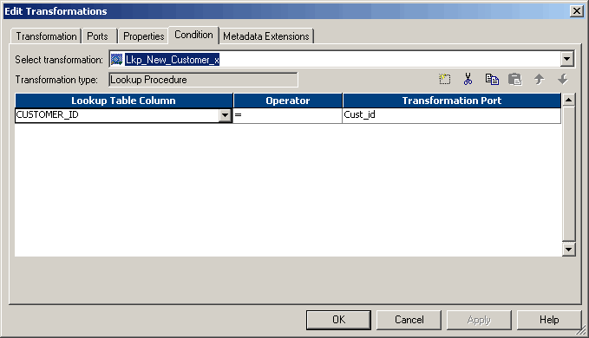
4.1: Lookup Transformation
Description
Used to look up data in a relational table, view, or synonym
  Passive Transformation
  Can be Connected/Unconnected
  Has a Lookup condition
  Can be used to:
    Get a related value
    Perform a calculation
    Update slowly changing dimension tables
Figure 4.1
Notes:
A Lookup Transformation is used to look up data in a relational table, view, or synonym. A lookup definition can be imported from any relational database to which both the Informatica Client and Server can connect. Multiple Lookup Transformations can be used in a mapping.
The Integration service queries the lookup table based on the lookup ports in the transformation. It compares Lookup Transformation port values to lookup table column values based on the lookup condition. The result of the lookup is passed to other transformations and the target.
The Lookup Transformation can be used to:
Get a related value - For example, if the source table includes employee ID, but the target table requires employee name to make the summary data easier to read
Perform a calculation - Many normalized tables include values used in a calculation, such as gross sales per invoice or sales tax, but not the calculated value (such as net sales)
Update slowly changing dimension tables - Use a Lookup transformation to determine whether records already exist in the target

Slide 4
4.1: Lookup Transformation
Description (Contd..)
Connected Lookup | Unconnected Lookup
Part of the mapping data flow | Separate from the mapping data flow
Returns multiple values (by linking output ports to another transformation) | Returns one value (by checking the Return (R) port option for the output port that provides the return value)
Executed for every record passing through the transformation | Only executed when the lookup function is called
More visible, shows where the lookup values are used | Less visible, as the lookup is called from an expression within another transformation
Default values are used | Default values are ignored
Notes:
The Lookup Transformation can be configured in two ways, Connected and Unconnected, to perform different types of lookups. These lookup transformations receive input and send output in different ways.
Connected - A connected Lookup Transformation can be configured to receive input directly from the mapping pipeline
Unconnected - An unconnected Lookup Transformation can be configured to receive input from the result of an expression in another transformation
A lookup condition has to be specified in the Condition tab. One input port is needed for each column used in the lookup condition. The same input port can be used more than once in a condition, and also multiple conditions can be specified.

Slide 5
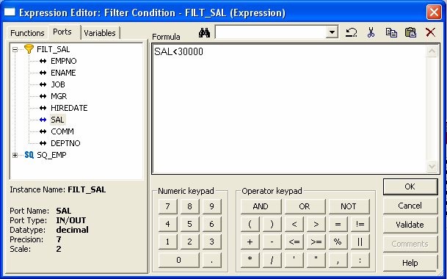
4.1: Lookup Transformation
Description (Contd..)
To configure a Lookup Transformation the following components are defined:
  Lookup table
  Ports
  Properties
  Condition
Figure 4.2
Notes:
To configure a Lookup Transformation the following components are defined:
Lookup source - Lookup source can be created from the following locations:
Relational or flat file source or target definition in repository
Source Qualifier definition in Mapping
Table or file that the Integration service and client can connect to
Lookup Ports - The Ports tab contains options similar to other transformations, such as port name, data type and scale. In addition to input and output ports, the Lookup Transformation includes a lookup port type that represents columns of data in the lookup table. An Unconnected Lookup Transformation also includes a return port type that represents the return value
Lookup Properties - The Properties tab is used to configure properties such as an SQL override for the lookup, the lookup table name, and tracing level for the transformation. Most of the options on this tab allow to configure caching properties
Lookup Condition - The condition or conditions that the Integration service has to use is specified in the conditions tab

Slide 6
4.1:Lookup Transformation
Connected Lookup Transformation
Input values directly from another transformation in the pipeline
For each input row, the Integration Service queries the lookup source or cache based on the lookup ports and the condition in the transformation
If the transformation is uncached or uses a static cache, the Integration Service returns values from the lookup query
If the transformation uses a dynamic cache
  It inserts the row into the cache when the row is not found
  It updates the row in the cache or leaves it unchanged
  It flags the row as insert, update, or no change
The Integration Service passes return values from the query to the next transformation. If the transformation uses a dynamic cache, you can pass rows to a Filter or Router transformation to filter new rows to the target.
Notes:
The following steps describe how the PowerCenter Server processes a connected Lookup transformation:
1. A connected Lookup transformation receives input values directly from another transformation in the pipeline.
2. For each input row, the PowerCenter Server queries the lookup source or cache based on
the lookup ports and the condition in the transformation.
3. If the transformation is uncached or uses a static cache, the PowerCenter Server returns
values from the lookup query.
If the transformation uses a dynamic cache, the PowerCenter Server inserts the row into
the cache when it does not find the row in the cache. When the PowerCenter Server finds
the row in the cache, it updates the row in the cache or leaves it unchanged. It flags the
row as insert, update, or no change.
4. The PowerCenter Server passes return values from the query to the next transformation. If the transformation uses a dynamic cache, you can pass rows to a Filter or Router transformation to filter new rows to the target.

Slide 7
4.1:Lookup Transformation
Unconnected Lookup Transformation
The following steps describe the way the PowerCenter Server processes an unconnected Lookup transformation:
  An unconnected Lookup transformation receives input values from the result of a :LKP expression in another transformation, such as an Update Strategy transformation
  The Integration Service queries the lookup source or cache based on the lookup ports and condition in the transformation
  The Integration Service returns one value into the return port of the Lookup transformation
  The Lookup transformation passes the return value into the :LKP expression
Notes:
An unconnected Lookup transformation receives input values from the result of a :LKP expression in another transformation. You can call the Lookup transformation more than once in a mapping.
A common use for unconnected Lookup transformations is to update slowly changing dimension tables.

Slide 8
Lookup Caches
When configuring a lookup cache, you can specify any of the following options:
  Static cache:
  Dynamic cache:
  Persistent cache:
  Shared cache:

Slide 9
Non-Persistent Cache
By default, the Integration Service uses a non-persistent cache when you enable caching in a Lookup transformation.
The Integration Service deletes the cache files at the end of a session.
The next time you run the session, the Integration Service builds the memory cache from the database
Notes:
Lookups are cached by default in Informatica. Informatica, by default brings in the entire data of the lookup table from database server to Informatica Server as a part of lookup cache building activity during session run.

Slide 10
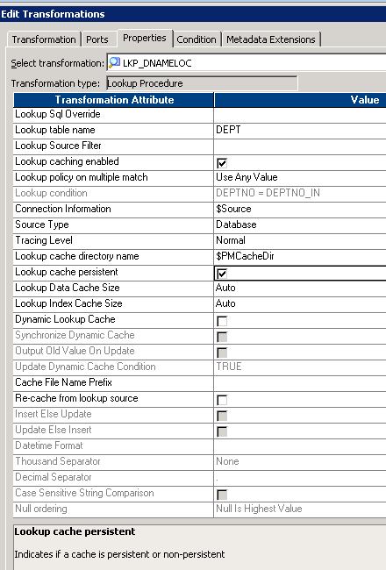
Persistent Cache
If you want to save and reuse the cache files, the transformation can be configured to use a persistent cache.
Persistent cache is used when the lookup table does not change between session runs.
The first time the Integration Service runs a session using a persistent lookup cache, it saves the cache files to disk instead of deleting them.
The next time the Integration Service runs the session, it builds the memory cache from the cache files.
If the lookup table changes occasionally, you can override session properties to recache the lookup from the database.
Notes:
If the lookup table is too huge, the process of bringing data from database server to Informatica server will take time. It might be possible that you are looking up to the same table different times using different lookups in different mappings. It would take a long time building the lookup cache again and again for each lookup. In such scenario persistent cache can be used.

Slide 11
Other Types Of Cache
Static cache
Static Cache is same as a Cached Lookup in which once a Cache is created the Integration Service always queries the Cache instead of the Lookup Table.
In Static Cache when the Lookup condition is true it return value from lookup table else returns Null or Default value. In Static Cache the important thing is that you cannot insert or update the cache.
Dynamic cache
In Dynamic Cache we can insert or update rows in the cache when we pass the rows. The Integration Service dynamically inserts or updates data in the lookup cache and passes the data to the target. The dynamic cache is synchronized with the target
Shared cache
  When we use shared Cache Informatica server creates the cache memory for multiple lookup transformations in the mapping and once the lookup is done for the first lookup then memory is released and use that memory used by the other look up transformation.
  We can share the lookup cache between multiple transformations.
Unnamed cache is shared between transformations in the same mapping and
Named cache between transformations in the same or different mappings.
Notes:
If the lookup table is too huge, the process of bringing data from database server to Informatica server will take time. It might be possible that you are looking up to the same table different times using different lookups in different mappings. It would take a long time building the lookup cache again and again for each lookup. In such scenario persistent cache can be used.

Slide 12
Key Points to Remember
Where applicable, try to use small tables as Lookup table and minimize the cache – We should consider using the bigger table as a Source
  If feasible, try to replace lookup transformation with Joiner transformation.
Non-equi join is possible using Lookup transformation.
If a Lookup transformation specifies several conditions, you can improve lookup performance by placing all the conditions that use the equality operator first in the list of conditions that appear under the Condition tab.
When Looking upon a table, uncheck Lookup port(s) for unwanted columns to minimize the cache – never delete those ports from the transformation.

Slide 13
Demo
Creating a Lookup Transformation
Notes:
Steps to create a Lookup transformation:
In the Mapping Designer, choose Transformation | Create menu option. Select the Lookup Transformation. Enter a name for the lookup. The naming convention for Lookup Transformations is LKP_TransformationName. Click OK.
In the Select Lookup Table dialog box choose the lookup table. Click the Import button if the lookup table is not in the source or target database.
To manually define the Lookup Transformation, click the Skip button.
Define input ports for each Lookup condition.
For an Unconnected Lookup Transformation, create a return port for the value you want to return from the lookup.
Define output ports for the values you want to pass to another transformation.
Add the lookup conditions.
On the Properties tab, set the properties for the lookup.
Click OK.
For Unconnected Lookup Transformations, write an expression in another transformation using :LKP to call the Unconnected Lookup Transformation.

Slide 14
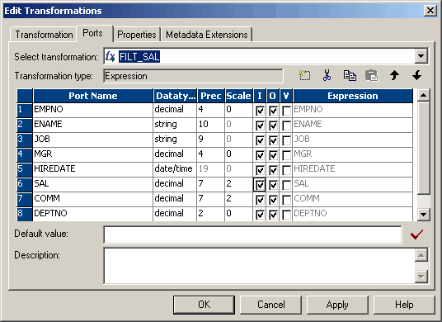
4.2. Filter Transformation Description
Used to filter rows in a Mapping.
  Active transformation
  Specify a filter condition which returns TRUE or FALSE
  Records that return TRUE are allowed to pass
  Filtered records are lost
Figure 4.3
Notes:
The Filter Transformation limits the rows sent to the target or other transformations. All the rows from a source transformation can be passed through the Filter Transformation based on a filter condition. All ports in a Filter Transformation are input/output, and only rows that meet the condition pass through the Filter Transformation. In some cases, you need to filter data based on one or more conditions before writing it to targets. For example, if you have a human resources target containing information about current employees, you might want to filter out employees who have resigned.

Slide 15
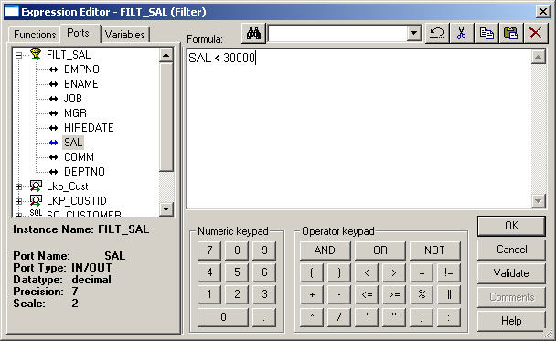
Filter Condition
Filter Condition is entered in the Expression Editor of the Filter transformation
The transformation language is used to enter the filter condition expression
Figure 4.4
Notes:
The Filter Condition can be entered in the expression editor. The expression editor is invoked by clicking on down arrow next to Filter Condition option under the Properties tab of Edit Transformation window.
For example, if you want to filter out rows for employees whose salary is less than $30,000, you enter the following condition:
SALARY < 30000
Multiple conditions can be defined using the AND and OR logical operators. TRUE and FALSE values are implicit return values from any condition and hence need not be specified in the condition expression. If the filter condition evaluates to NULL, the row is assumed to be FALSE.

Slide 16
Demo
Creating a Filter Transformation
Notes:
Steps to create a Filter transformation:
In the Designer, switch to the Mapping Designer and open a mapping.
Choose Transformation | Create menu option. Select Filter Transformation, and enter the name of the new transformation. Click Create, and then click Done.
Select and drag all the desired ports from a source qualifier or other transformation to add them to the Filter Transformation. After the ports are selected and dragged, copies of these ports appear in the Filter Transformation.
Double-click the title bar of the new transformation.
Click the Properties tab. A default condition appears. The default condition is TRUE (constant with a numeric value of 1).
Click the Value section of the condition, and then click the Open button. The Expression Editor appears.
Enter the filter condition to be applied. Use values from one of the input ports in the transformation as part of this condition. However, values from output ports in other transformations can also be used.
Click Validate to check the syntax of the conditions entered. Fix syntax errors before continuing.
Click OK.
Choose Repository | Save menu option to save the mapping.

Slide 17
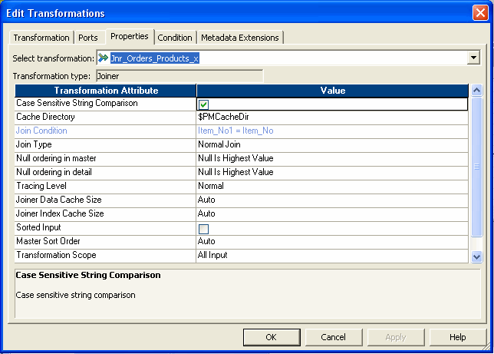
4.3. Joiner Transformation Description
Used to join two related heterogeneous sources
  Active transformation
  Heterogeneous
    Relational tables in separate databases
    Files in separate file systems
    A relational and a flat file
  Settings for joiner
    Master and detail source
    Type of join
    Condition of
Figure 4.5
Notes:
While a Source Qualifier Transformation can join data originating from a common source database, the Joiner transformation joins two related heterogeneous sources residing in different locations or file systems.
The combination of sources can be varied. The following sources can be used:
Two relational tables existing in separate databases
Two flat files in potentially different file systems
Two different ODBC sources
Two instances of the same XML source
A relational table and a flat file source
A relational table and an XML source

Slide 18
Demo
Creating a Joiner Transformation
Notes:
Steps to create a Joiner Transformation:
In the Mapping Designer, choose Transformation | Create menu option. Select the Joiner Transformation. Enter a name, click OK. The naming convention for Joiner transformations is JNR_TransformationName.
Enter a description for the transformation. This description appears in the Repository Manager, making it easier for all to understand or remember what the transformation does.
Drag all the desired input/output ports from the first source into the Joiner Transformation. The Designer creates input/output ports for the source fields in the Joiner, as detail port by default. This property can be edited later.
Select and drag all the desired input/output ports from the second source into the Joiner Transformation. The Designer configures the second set of source fields and master fields by default.
Double-click the title bar of the Joiner Transformation to open the Edit Transformations dialog box.
Select the Ports tab.

Slide 19
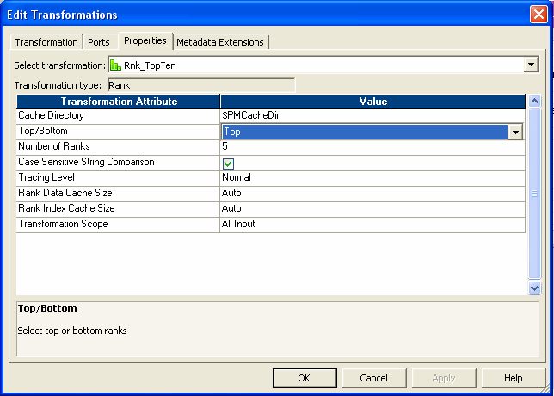
4.4. Rank Transformation Description
Used to select only the top or bottom rank of data.
  Active transformation
  Generates the Rank Index
  Grouping can be done
Figure 4.6
Notes:
The Rank Transformation is used to select only the top or bottom rank of data. It can be used to return the largest or smallest numeric value in a port or group.
The Rank Transformation differs from the transformation functions MAX and MIN, in that it allows to select a group of top or bottom values, not just one value. For example, use Rank to select the top 10 salespersons in a given territory. Or, to generate a financial report, can also be used to identify the three departments with the lowest expenses in salaries and overhead. While the SQL language provides many functions designed to handle groups of data, identifying top or bottom strata within a set of rows is not possible using standard SQL functions.
All ports representing the same row set can be connected to the transformation. Only the rows that fall within that rank, based on some measure set during configuration, pass through the Rank Transformation. Expression to transform data or perform calculations can also be written.

Slide 20
Demo
Creating a Rank Transformation
Notes:
Steps to create a Rank Transformation:
In the Mapping Designer, choose Transformation | Create menu option. Select the Rank Transformation. Enter a name for the Rank. The naming convention for Rank Transformations is RNK_TransformationName.
Enter a description for the transformation.
Click OK, and then click Done. The Designer creates the Rank Transformation.
Link columns from an input transformation to the Rank Transformation.
Click the Ports tab, and then select the Rank (R) option for the port used to measure ranks.
To create groups for ranked rows, select Group By for the port that defines the group.
Click the Properties tab and select either the top or bottom rank. For the Number of Ranks option, enter the number of rows to select for the rank.
Click OK to return to the Designer.
Choose Repository | Save menu option.

Slide 21

4.5. Working with Flat Files Description
Flat files can be used as sources and targets in a mapping.
Flat file source definitions can be imported or created in the Source Analyzer.
Flat file target definitions can be imported or created in the Target designer.
Fixed-width and delimited flat file source and target definitions can be imported.
Flat File Wizard is used to import flat files.
Figure 4.7
Notes:
Flat Files can be used as sources and targets in a mapping. To do so, flat file sources and targets must be defined in the repository. Flat file source definitions can be imported or created in the Source Analyzer. Flat file target definitions can be imported or created in the Target designer.
After the file source and target definitions are created, they can be used in mappings.
Note: Because source definitions must exactly match the source, Informatica recommends importing file source definitions instead of creating them manually.

Slide 22
Demo
Import a Flat File
Notes:
Steps to import a Flat file definition:
Open the Source Analyzer and choose File | Sources | Import menu option. -or-
Open the Target designer and choose File | Targets | Import menu option. The Open Flat File dialog box appears.
Click OK. The contents of the file appear in the window at the bottom of the Flat File Wizard.
Edit the following settings as necessary:
Flat File Type
A name for this source or target
Start Import At Row
Import Field Names From First Line
Click Next.
Follow the instructions given in the wizard to manipulate the column breaks in the file preview window. Move existing column breaks by dragging them. Double-click a column break to delete it. In case of a de-limited flat file, column breaks are automatically created based on the delimiter.
Click Next.
Enter column information for each column in the file.
Click Finish.
Choose Repository | Save menu option to save.

Slide 23
Summary
After completing this lesson you now:
  Know how to configure the following transformations
    Lookup
    Filter
    Joiner
    Rank
  Know how to work with flat files as source or target definitions

Slide 24
Review Question
Question 1: _________ lookup transformation is part of the mapping data flow.
Question 2: To rank values _________ is created in the rank transformation.
Question 3: A Joiner transformation can only be used for relational sources.
  True/False
Question 4: Flat files can be used as sources and targets in a mapping.
  True/False

